Slide 1

Chapter 4
Security in the Software Development Life Cycle

Slide 2
Introduction to Secure Software Development
Integrating security practices at every stage of the Software Development Lifecycle (SDLC).
Purpose: To prevent vulnerabilities and create software resistant to potential attacks.
Software Vulnerabilities: Exploited by attackers to:
Gain unauthorized access
Disrupt operations
Steal sensitive data
Why Secure Software Development?
Software security ensures data protection, privacy, and system integrity.
Early integration of security measures saves costs and reduces risks.
Protects both users and organizations from cyber threats.
Key Practices
Incorporate security in the design phase.
Conduct code reviews and testing for security vulnerabilities.
Implement security controls such as encryption, authentication, and access control.

Slide 3
Design, Implementation, Testing, Deployment and Maintenance Phase
Design: Applying Secure Design Principles
Incorporate secure design principles to minimize vulnerabilities.
Use techniques like threat modelling to identify potential security issues.
Implementation: Secure Coding Practices
Follow secure coding practices to prevent common flaws, such as input validation and proper error handling.
Avoid using deprecated or insecure libraries.
Testing: Identifying and Fixing Vulnerabilities
Conduct security testing, including code reviews, penetration testing, and vulnerability scanning.
Fix vulnerabilities before the software goes live.
Deployment: Implementing Security Measures
Implement security controls such as encryption, firewalls, and access management during software deployment.
Maintenance: Continuous Monitoring and Updates
Continuously monitor the software for new threats.
Regularly update the software to address security vulnerabilities and emerging threats.

Slide 4

SDLC
•
•
•
•
Systems Development Live Cycle
or Software Development Live Cycle Security included in every phase NIST Special Publication 800-14

Slide 5





SDLC Phases
•
•
•
•
•
Initiation
Development / Acquisition Implementation
Operation Disposal
•
Security plan should be first step

Slide 6



SDLC Overview
•
•
Prepare security plan
Initiation: define need and purpose
Sensitivity Assessment Development / Acquisition
•
Determine security requirements and incorporate them into specifications
Implementation
Install controls, security testing, accreditation
•

Slide 7



SDLC Overview
•
Operation / Maintenance
Security operations and administration: backups, training, key management, etc.
Audits and monitoring
•
•
Disposal
•
•
Archiving
Media sanitization

Slide 8


Code Repository Security
•
•
•
Like GitHub
Contents must be protected Developers shouldn't publish code that contains secrets

Slide 9
Programming Concepts

Slide 10
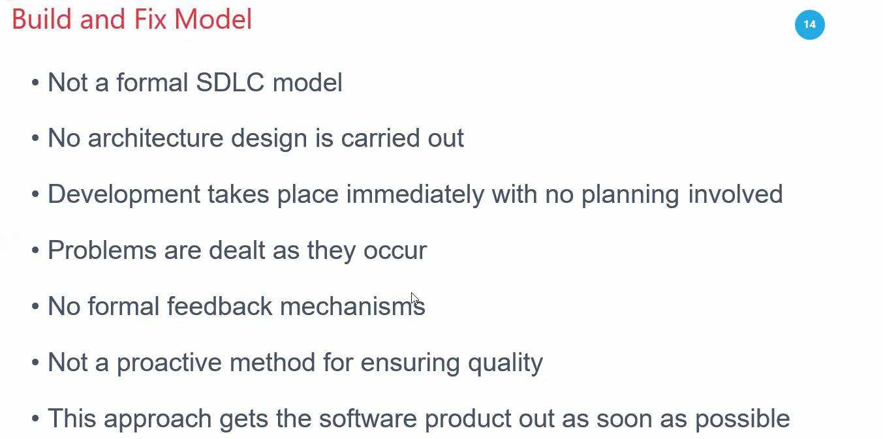

Slide 11
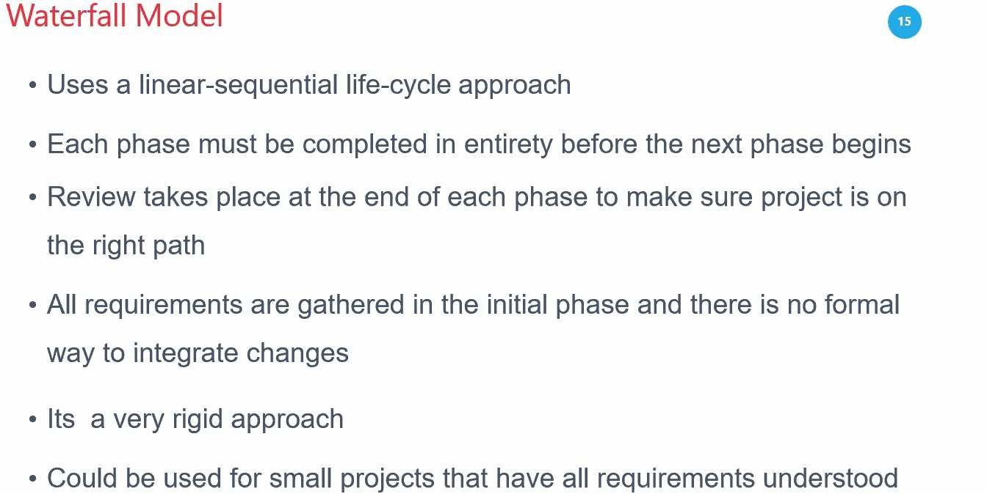

Slide 12
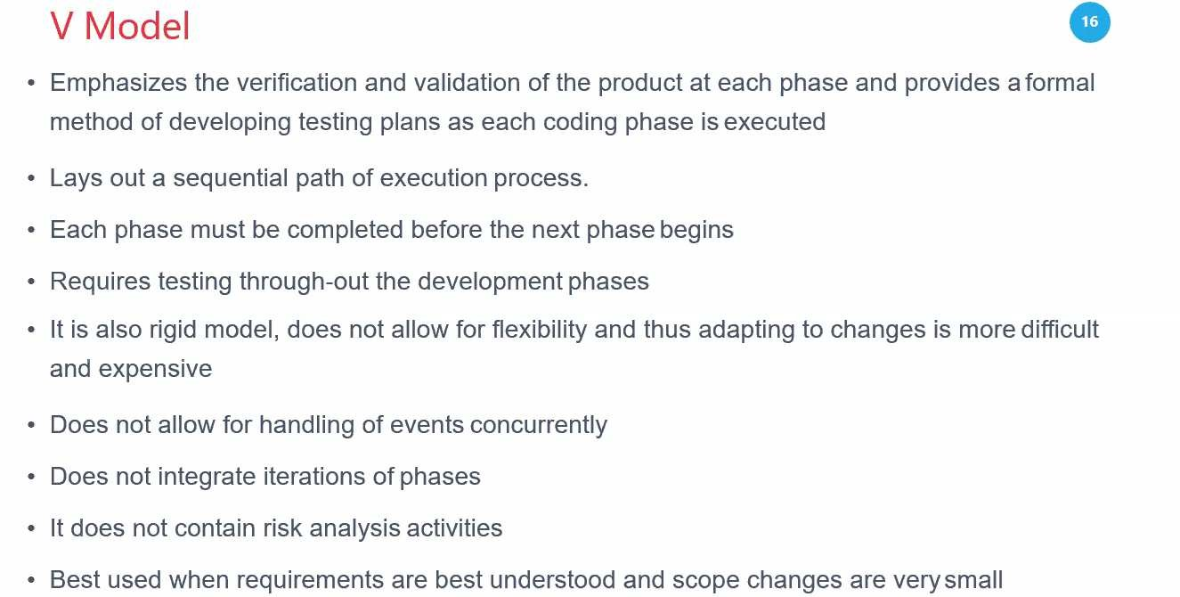

Slide 13
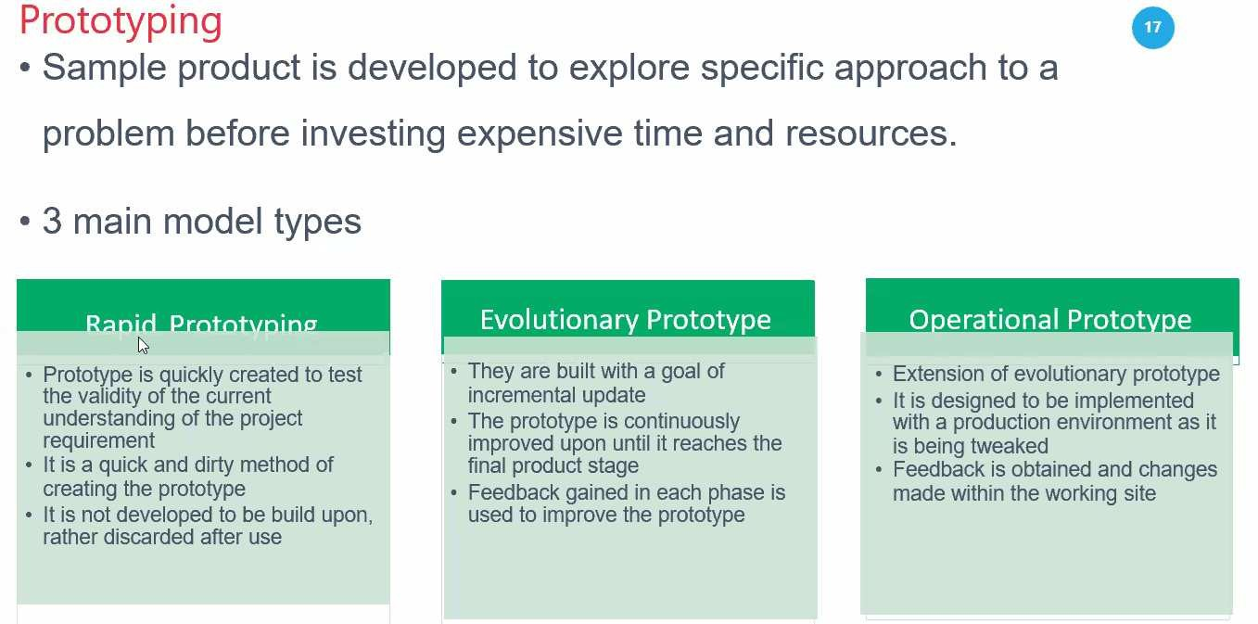

Slide 14
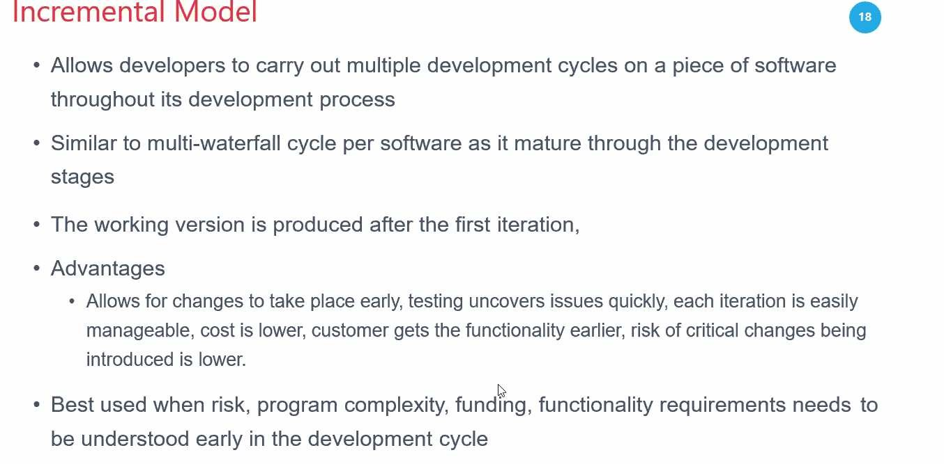

Slide 15
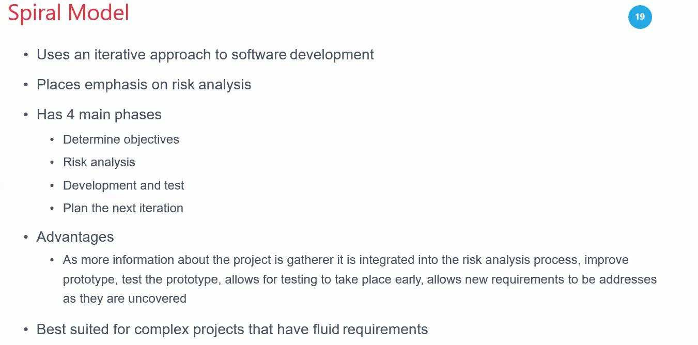

Slide 16
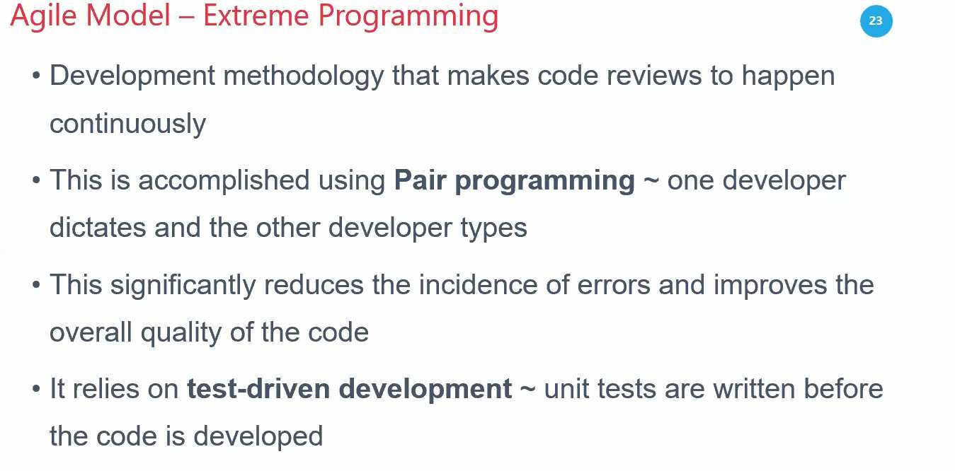

Slide 17
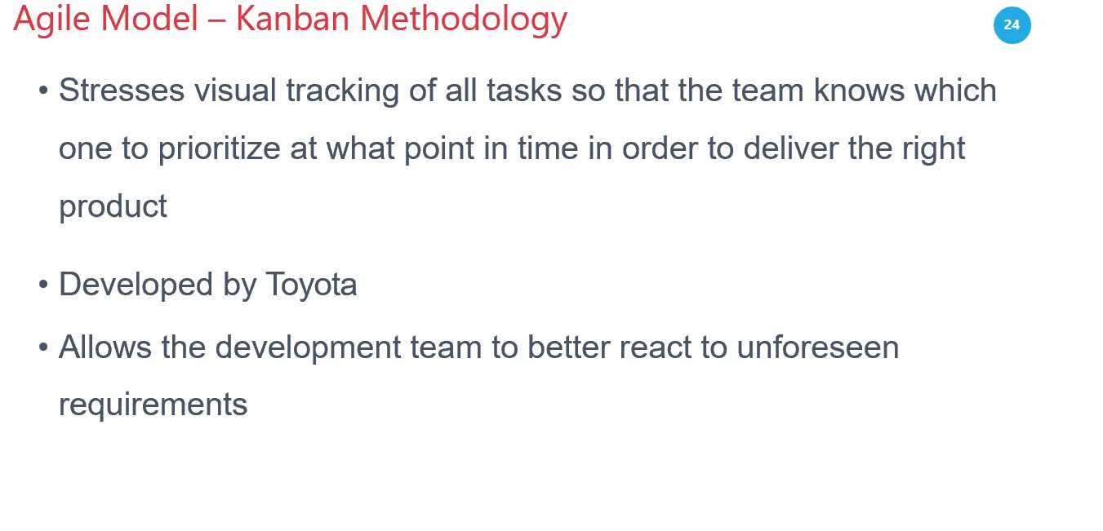

Slide 18
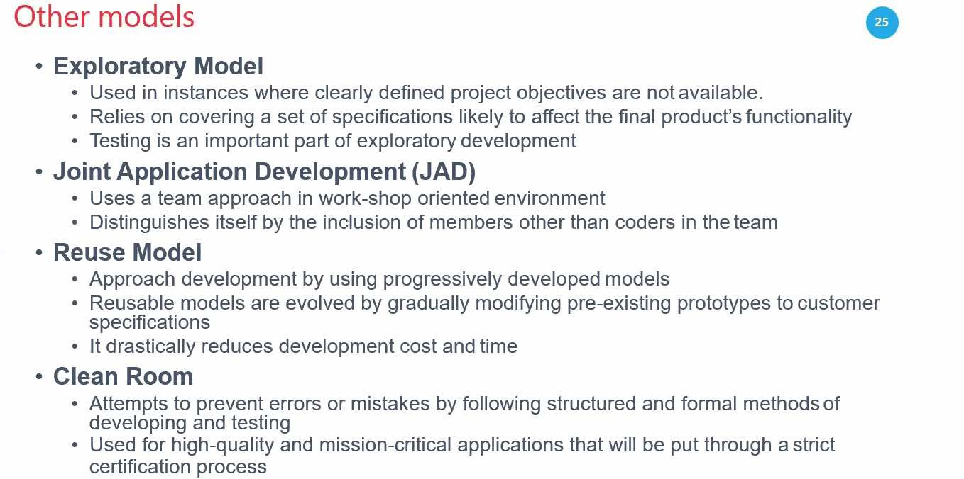

Slide 19
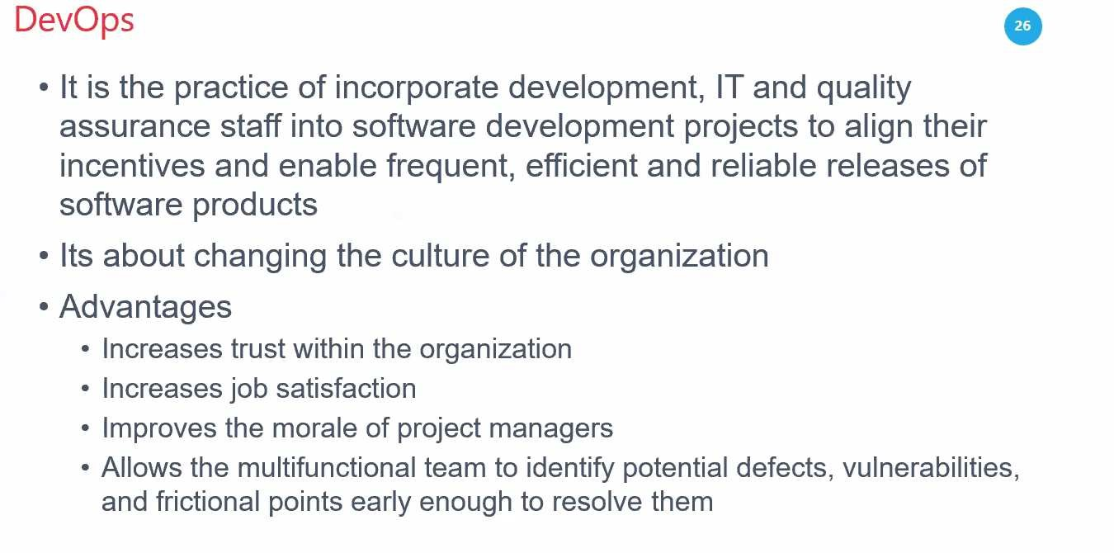

Slide 20
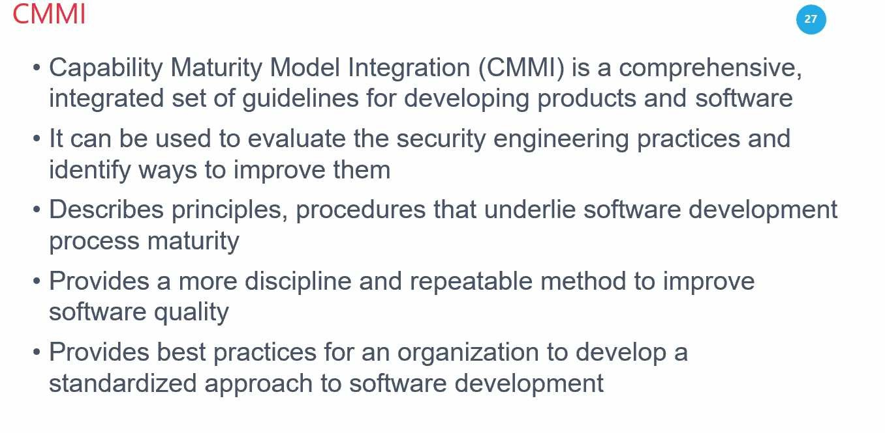

Slide 21
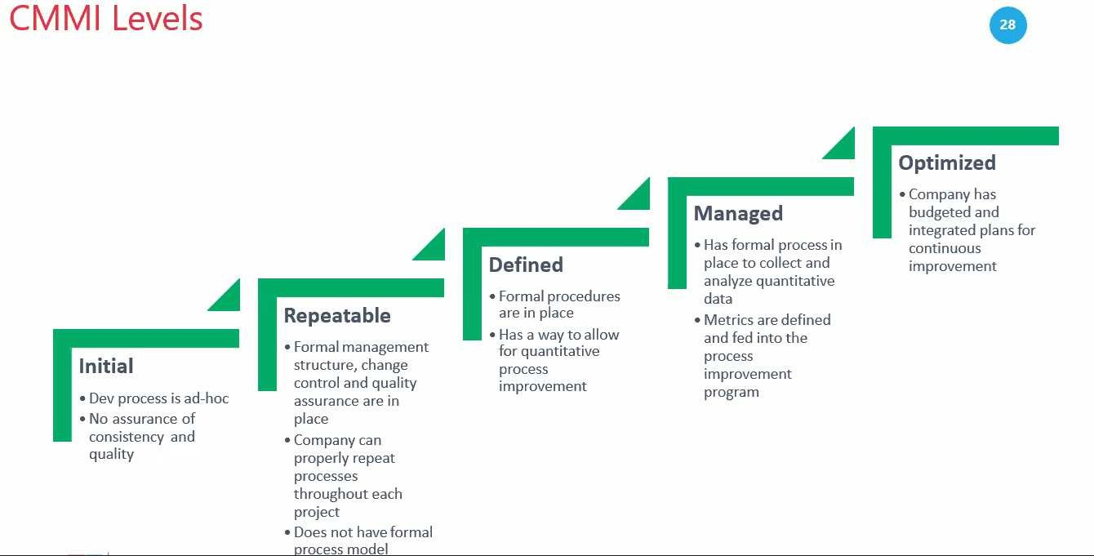

Slide 22

Software Change and Configuration Management
•
Ensures that changes occur in an orderly fashion, and don't harm security
NIST SP 80-128 describes a Configuration Management Plan (CMP)
•
•
•
•
•
Configuration Control Board (CCB) Configuration Item Identification Configuration Change Control Configuration Monitoring

Slide 23
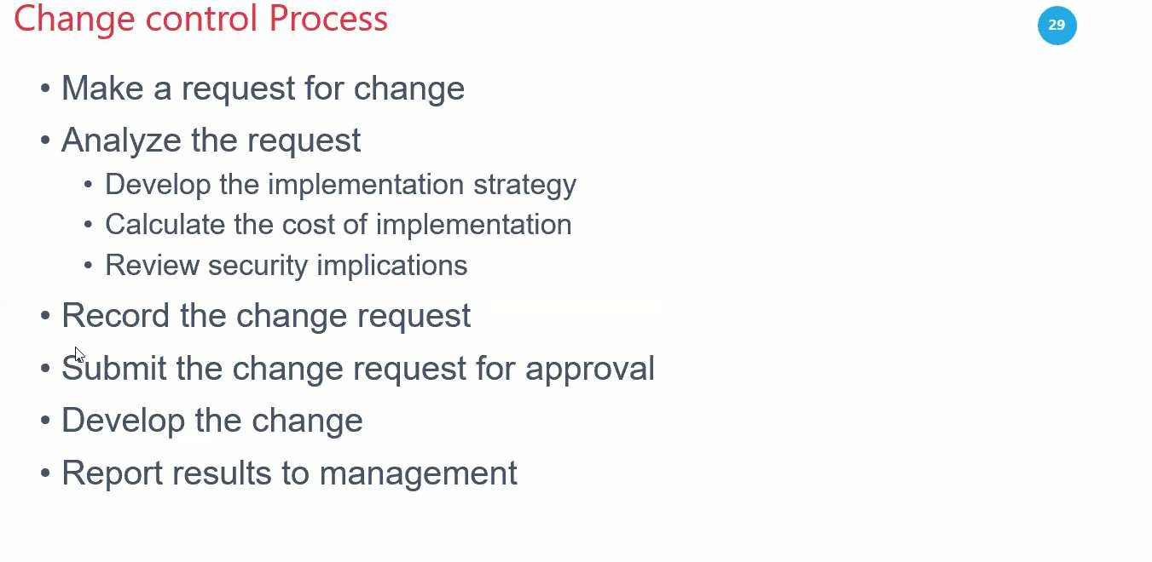

Slide 24
Software Change and Configuration Management
•
Ensures that changes occur in an orderly fashion, and don't harm security
NIST SP 80-128 describes a Configuration Management Plan (CMP)
•
•
•
•
•
Configuration Control Board (CCB) Configuration Item Identification Configuration Change Control Configuration Monitoring

Slide 25
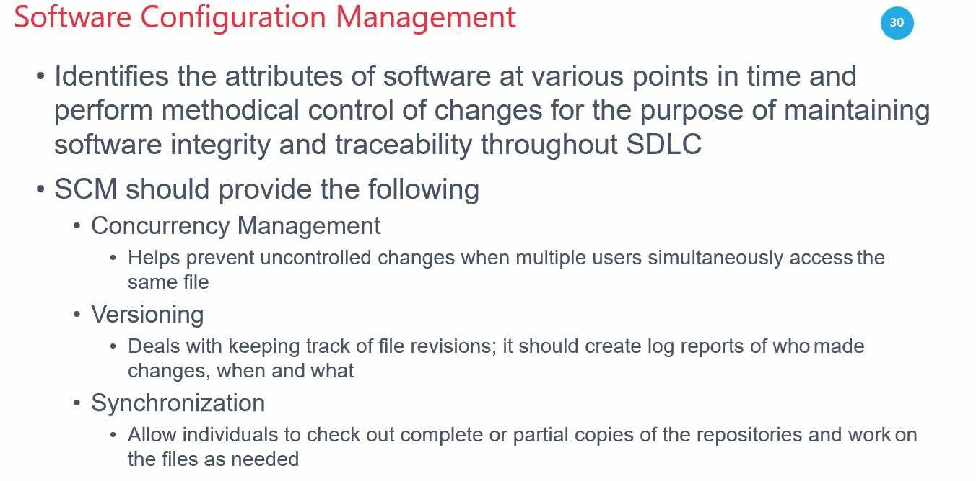

Slide 26


Slide 27
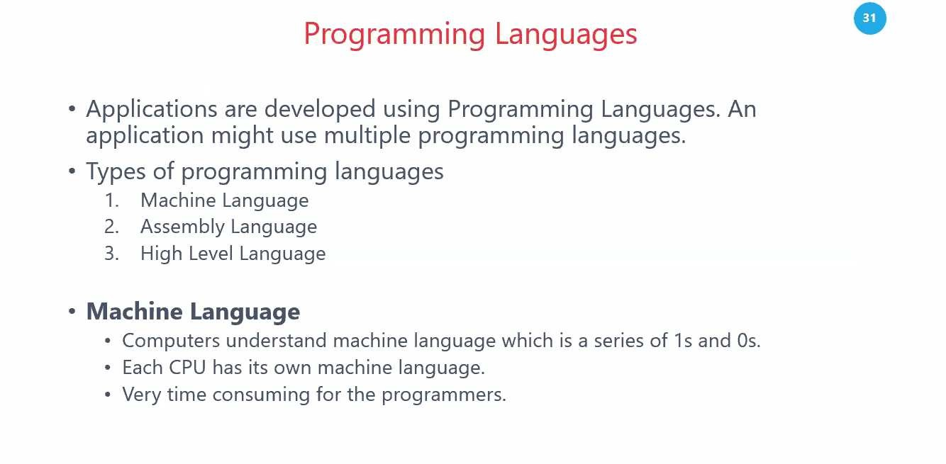

Slide 28
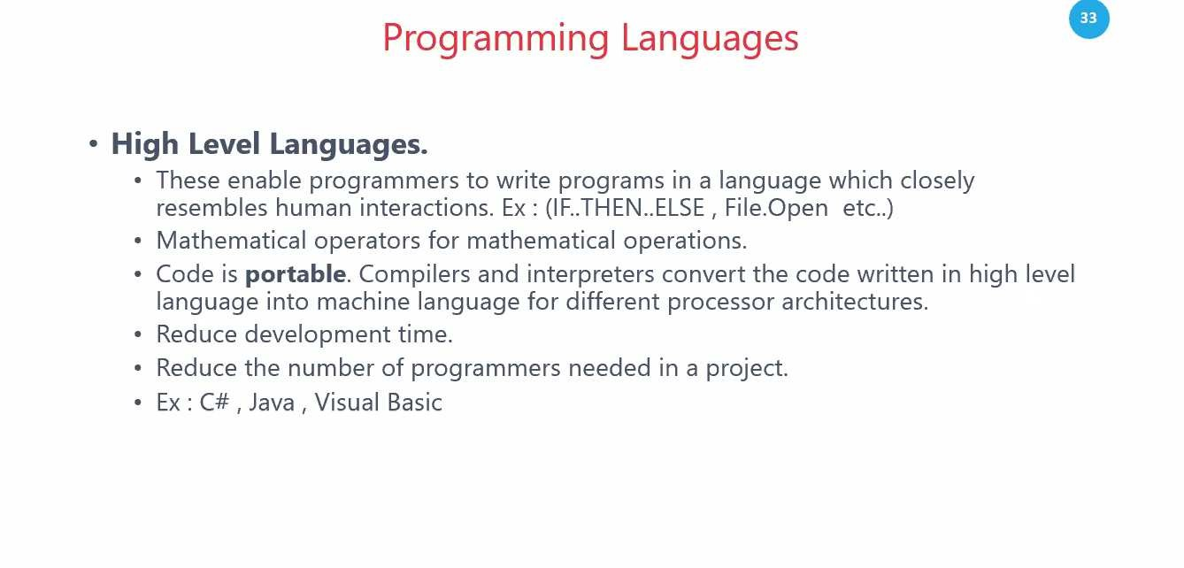

Slide 29
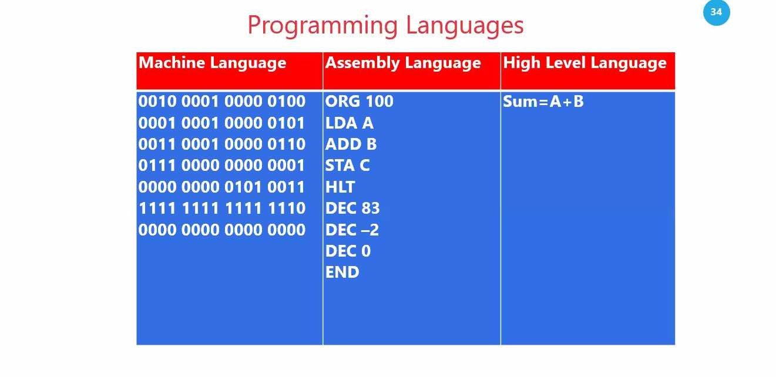

Slide 30
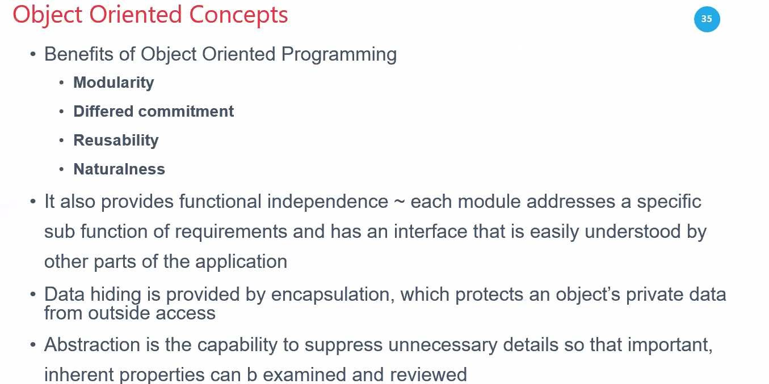

Slide 31


Computer-Aided Software Engineering (CASE)
•
Programs assist in creation and maintenance of other programs
Three types
•
•
•
•
Tools: support one task Workbenches: Integrate several tools Environments: Support entire process
•
4GL, object-oriented languages, and GUIs are used as components of CASE

Slide 32



Software Licensing
•
•
Public domain (free to use)
Proprietary software is copyrighted, and sometimes patented
EULA (End User License Agreement) Open-source licenses
•
•
•
•
•
GNU Public License (GPL)
Berkeley Software Distribution (BSD) Apache

Slide 33
Software Development Consepts

Slide 34


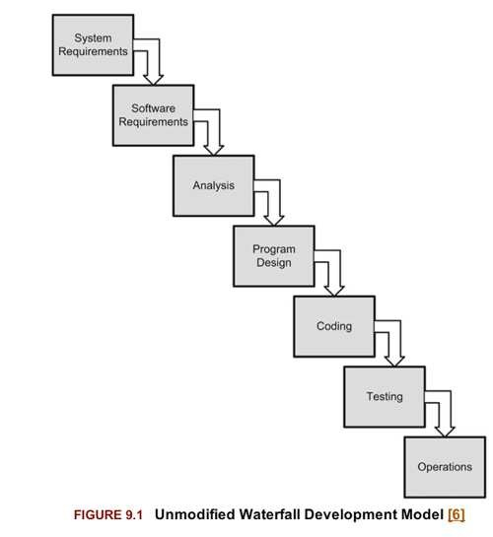



Waterfall Model
•
•
•
•
From 1969 One-way No iteration Unrealistic

Slide 35
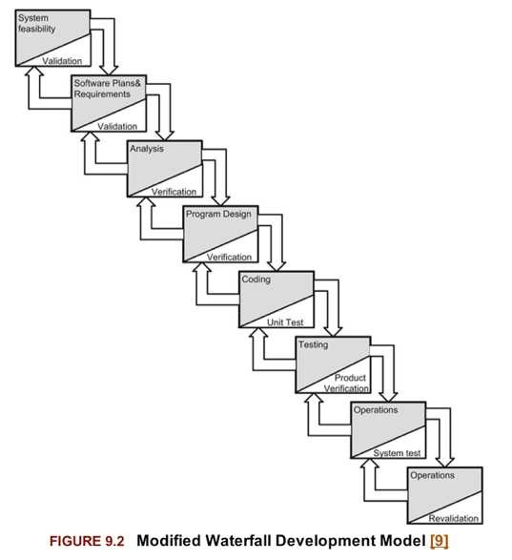
Modified Waterfall Model

Slide 36


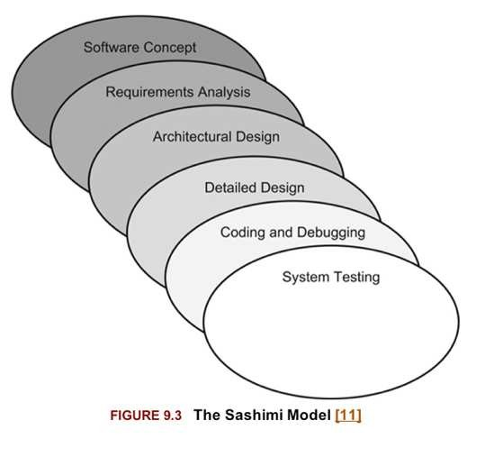

Sashimi Model
•
Steps overlap

Slide 37
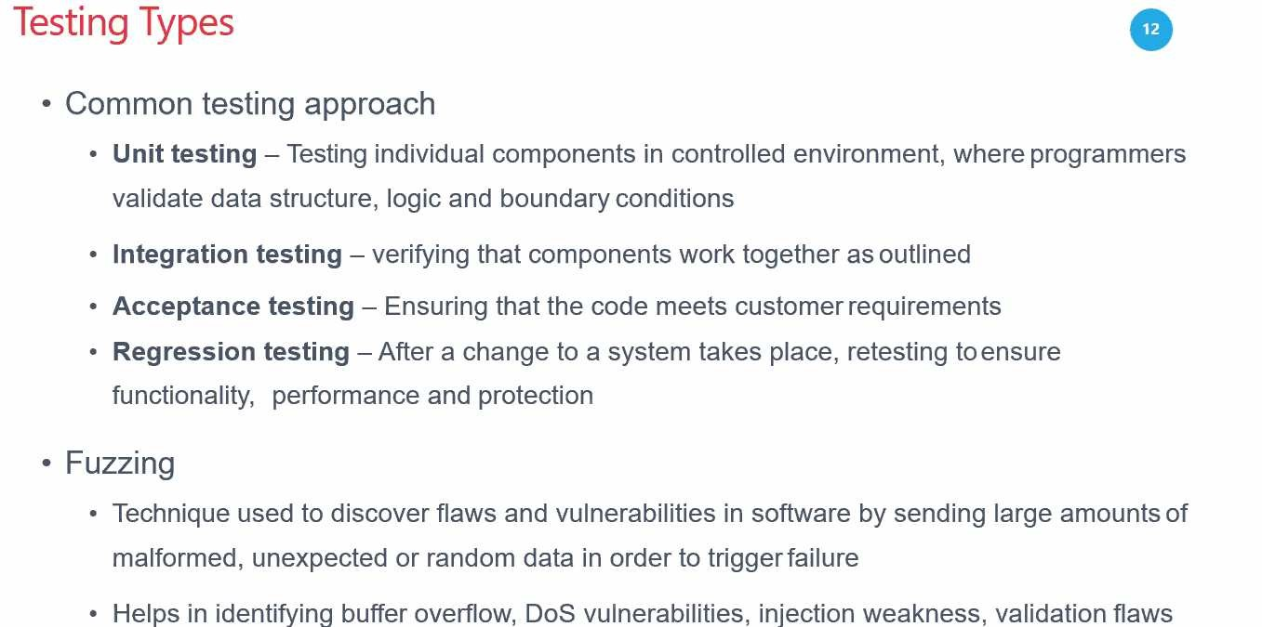

Slide 38



Spiral
•
•
Many rounds
Each round is a project; may use waterfall model
Risk analysis performed for each round
•

Slide 39
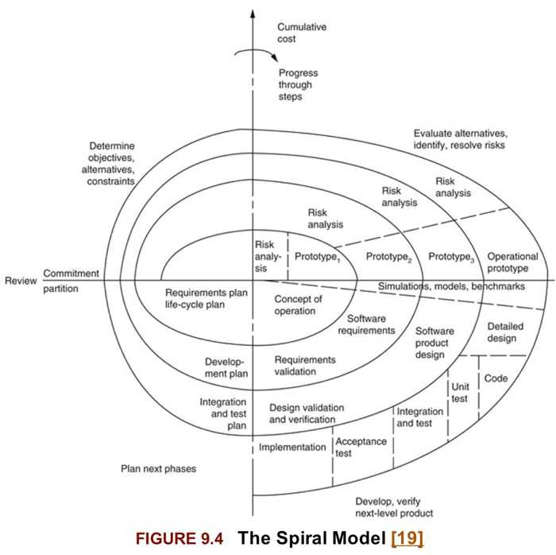

Slide 40
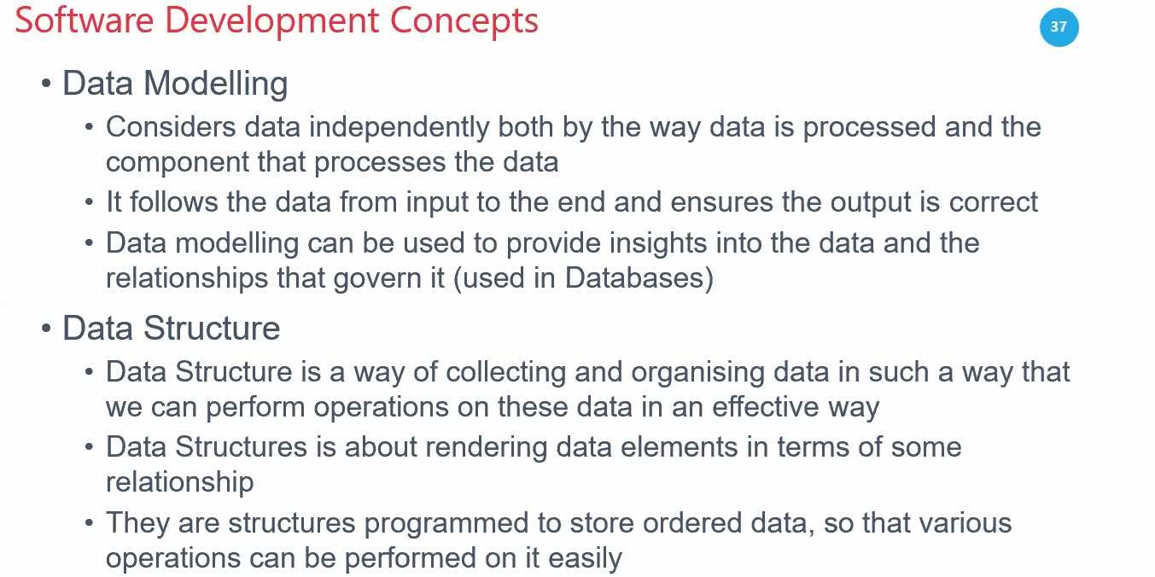

Slide 41
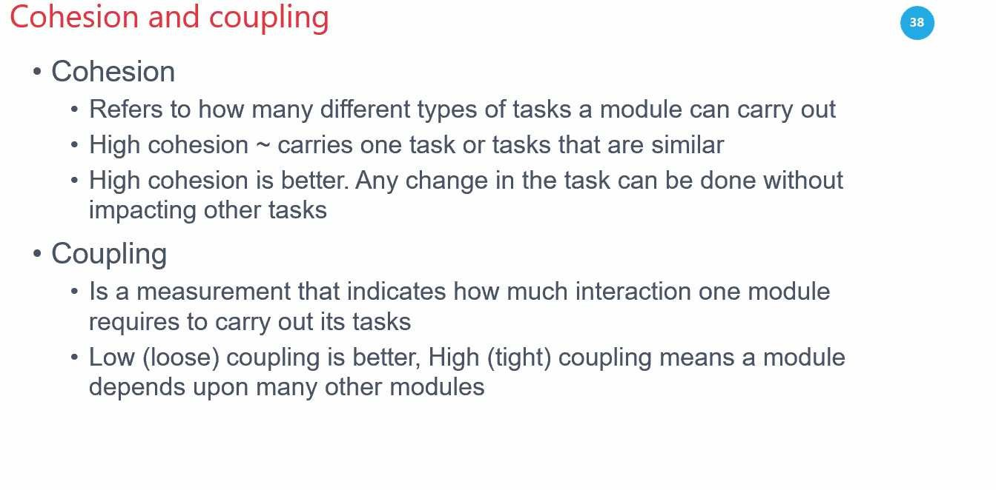

Slide 42
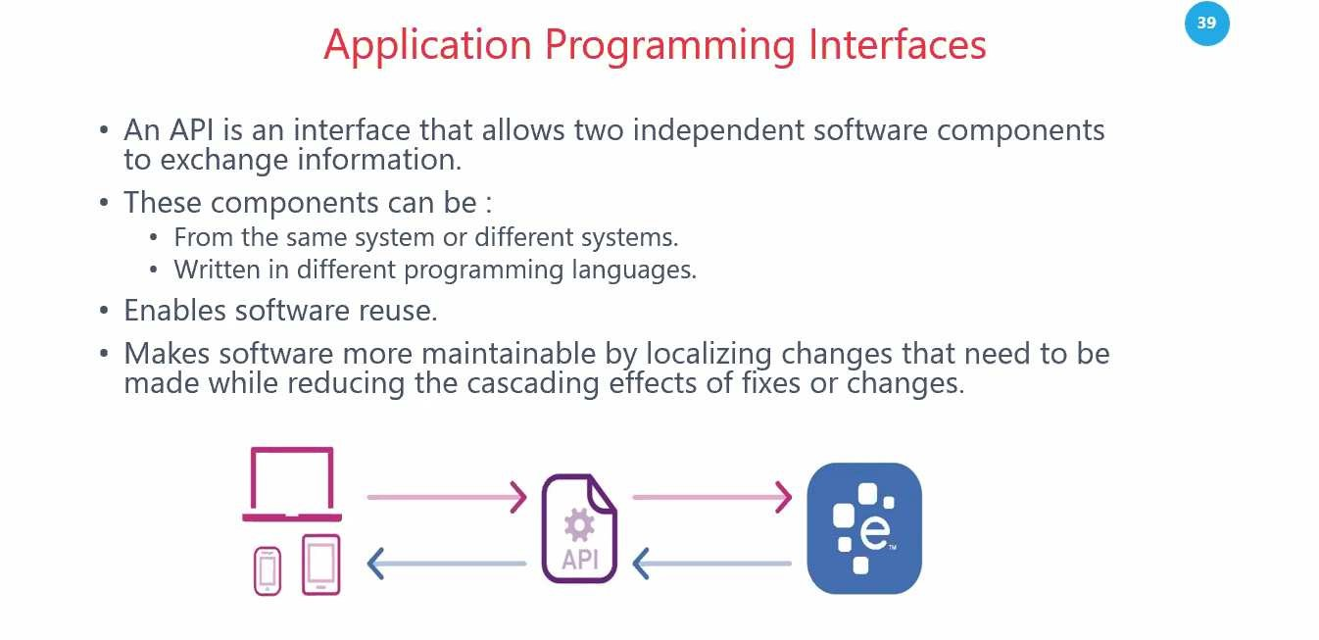

Slide 43
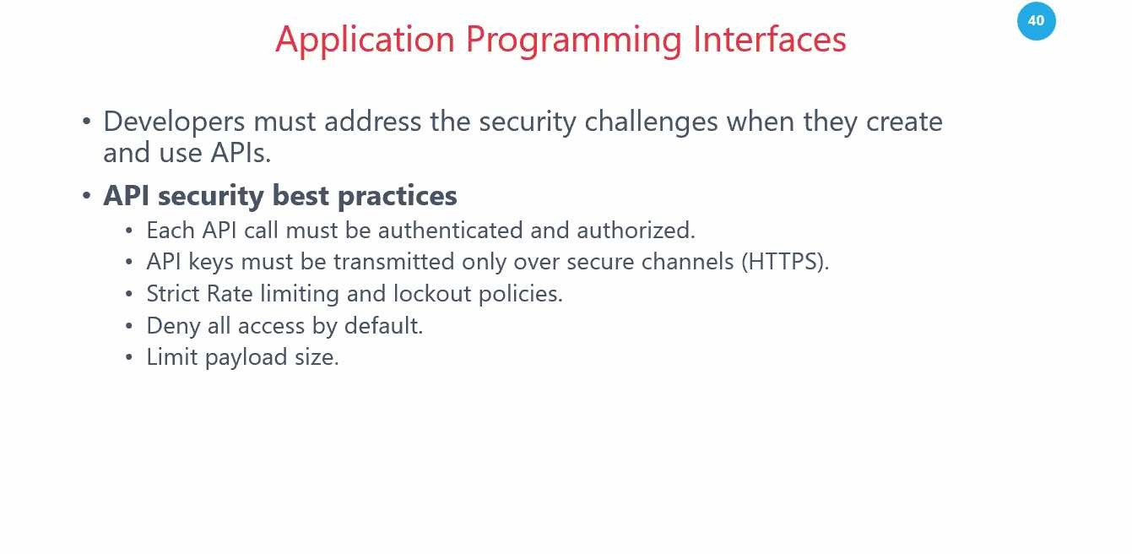

Slide 44
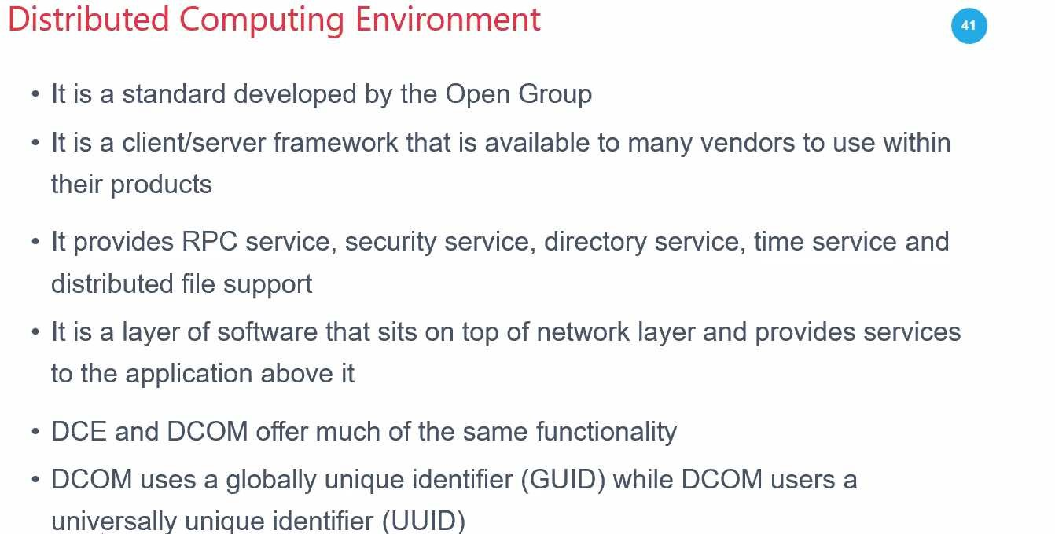
Notes:
A Remote Procedure Call (RPC) is a software communication protocol that one program uses to request a service from another program located on a different computer and network, without having to understand the network's details.
The DCOM wire protocol is based on Distributed Computing Environment/Remote Procedure Calls (DCE/RPC), which provides a standard for converting in-memory data structures into network packets. The DCOM protocol uses RPCs to expose application objects, while handling the low-level details of a network protocol.
(Distributed Computing Environment) Software from The Open Group that allows applications to be built across heterogeneous platforms in a network. DCE includes security, directory naming, time synchronization, file sharing, RPCs and multithreading services.

Slide 45
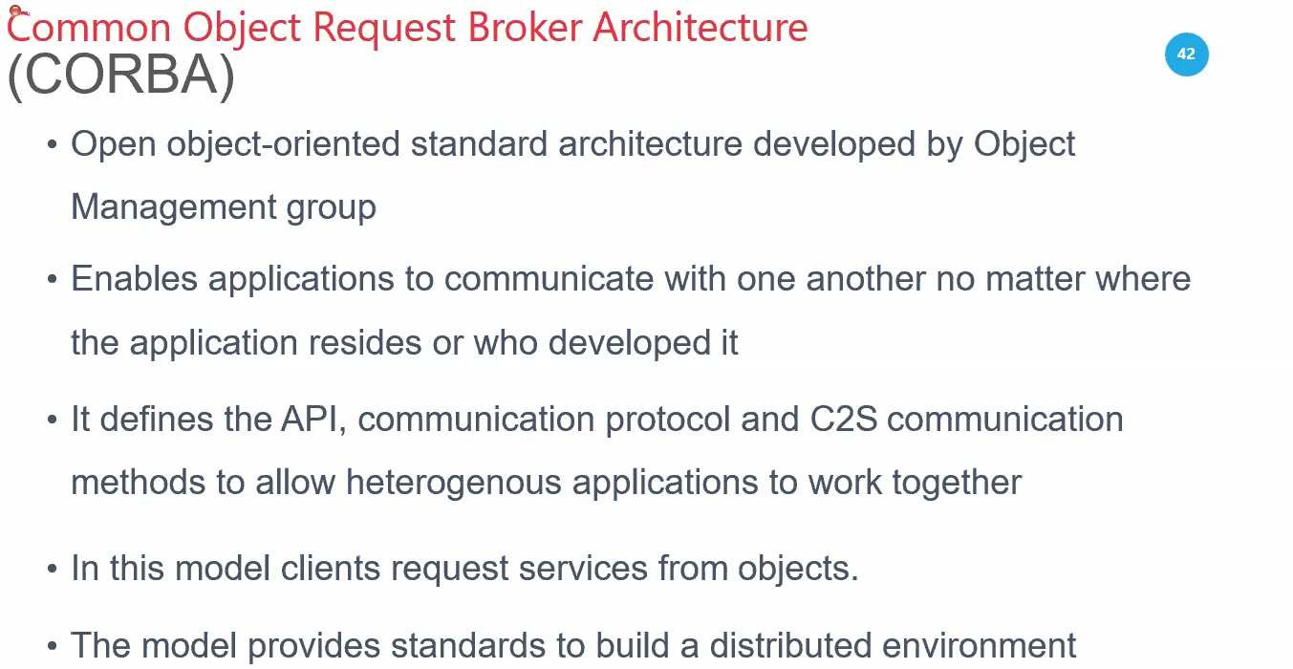

Slide 46
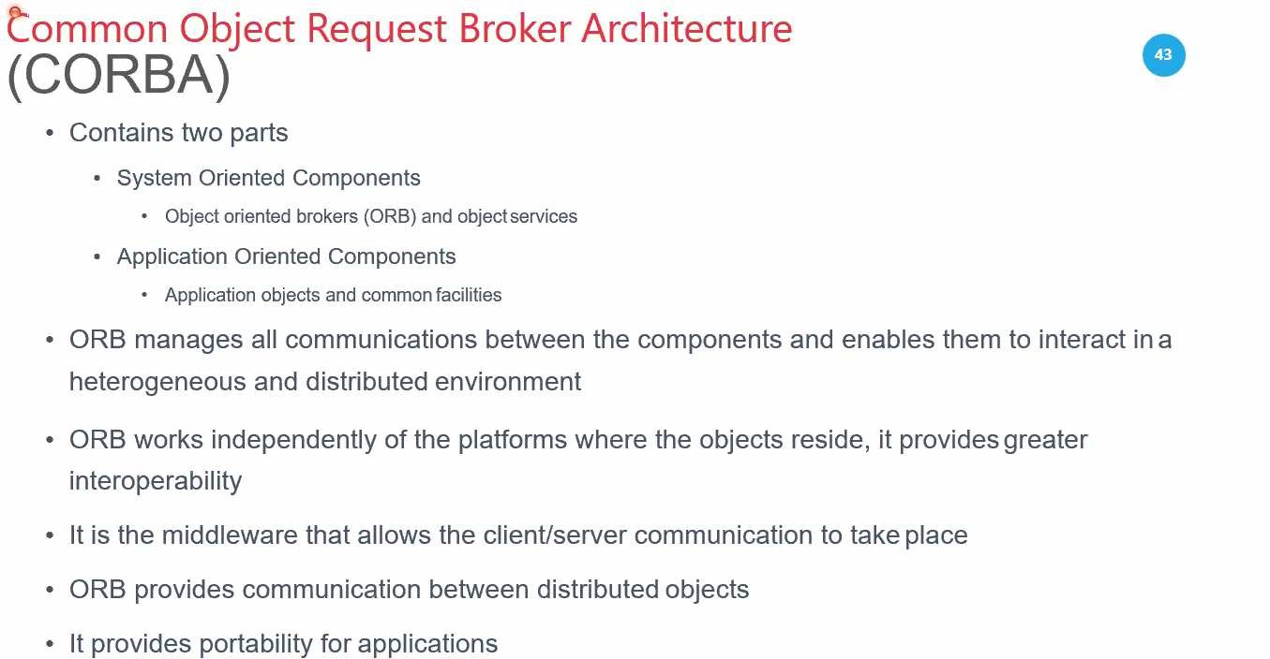

Slide 47
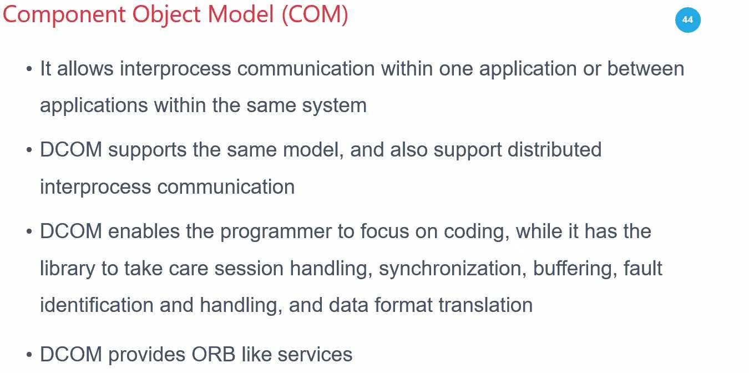

Slide 48
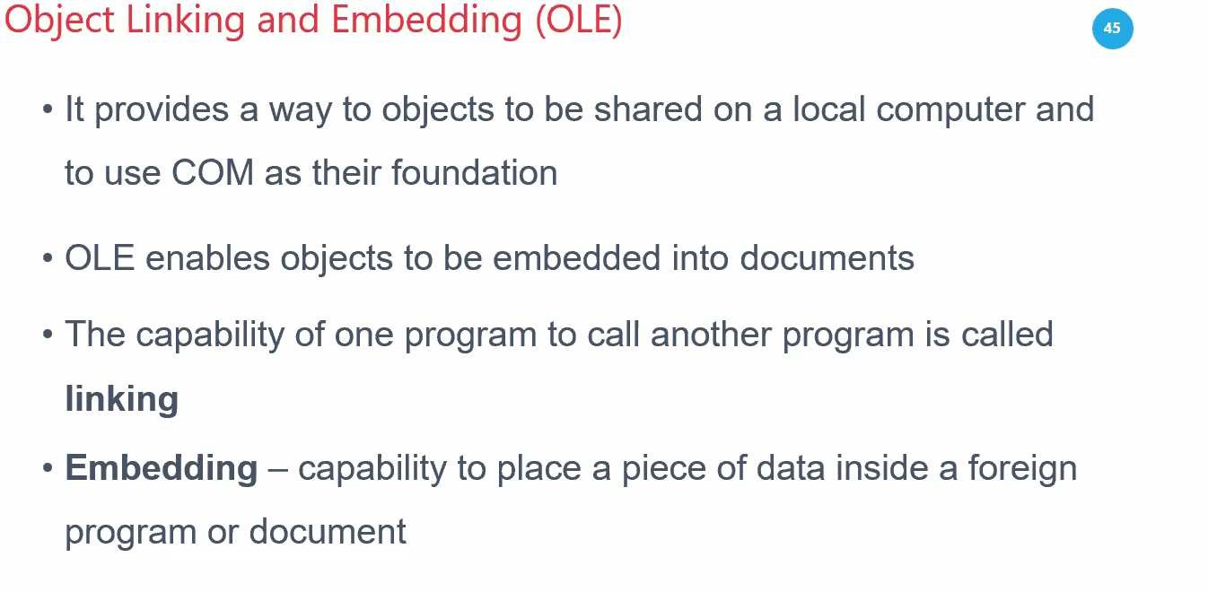

Slide 49
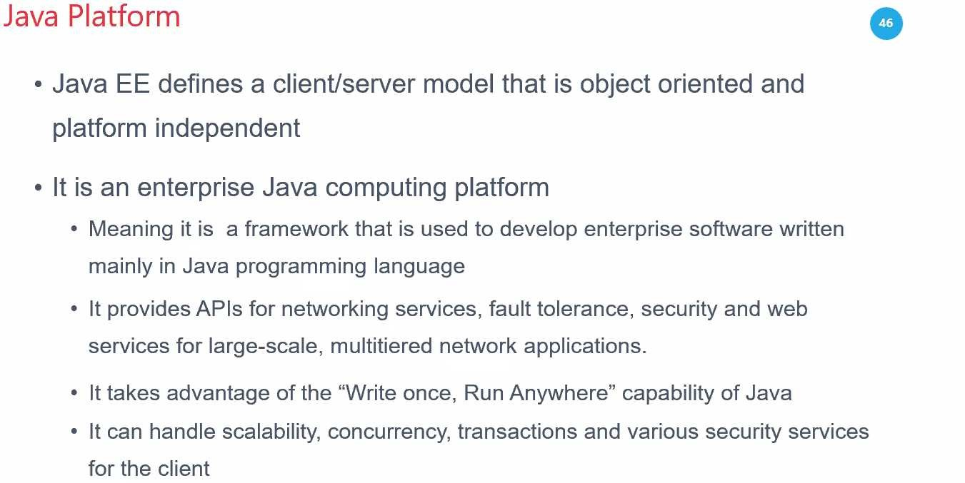

Slide 50
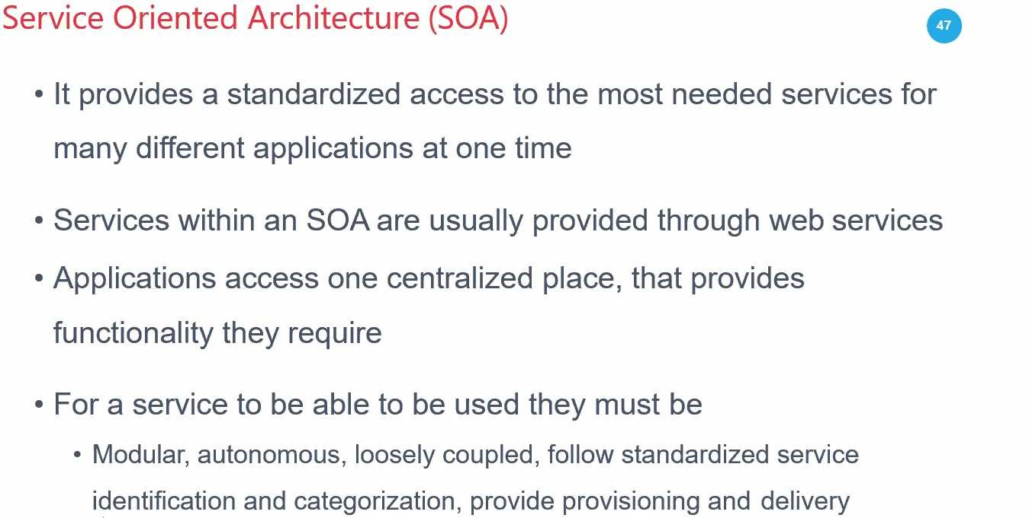

Slide 51
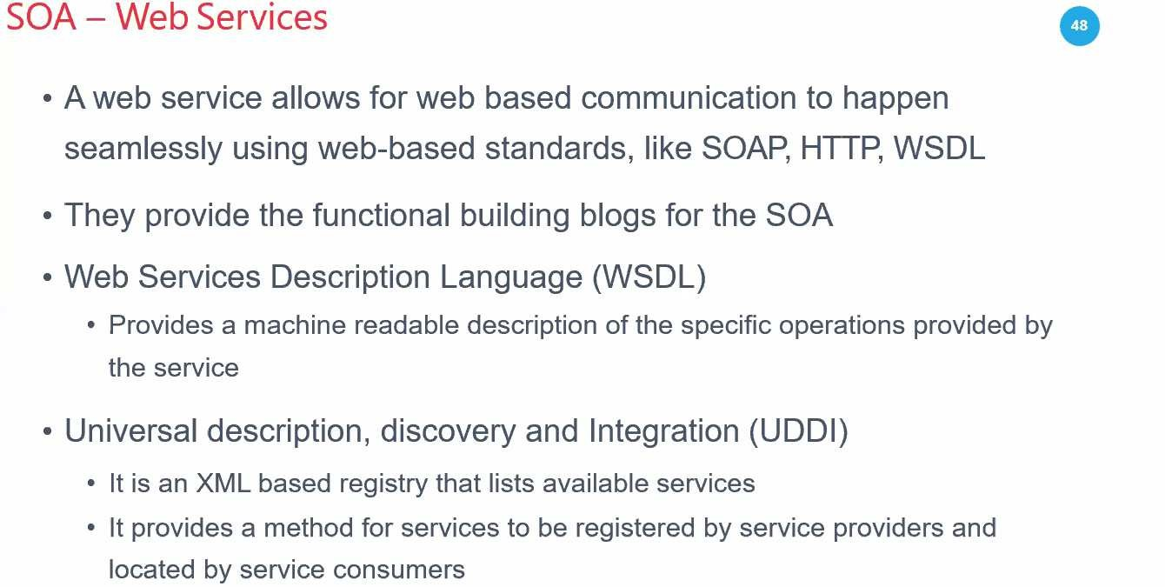

Slide 52
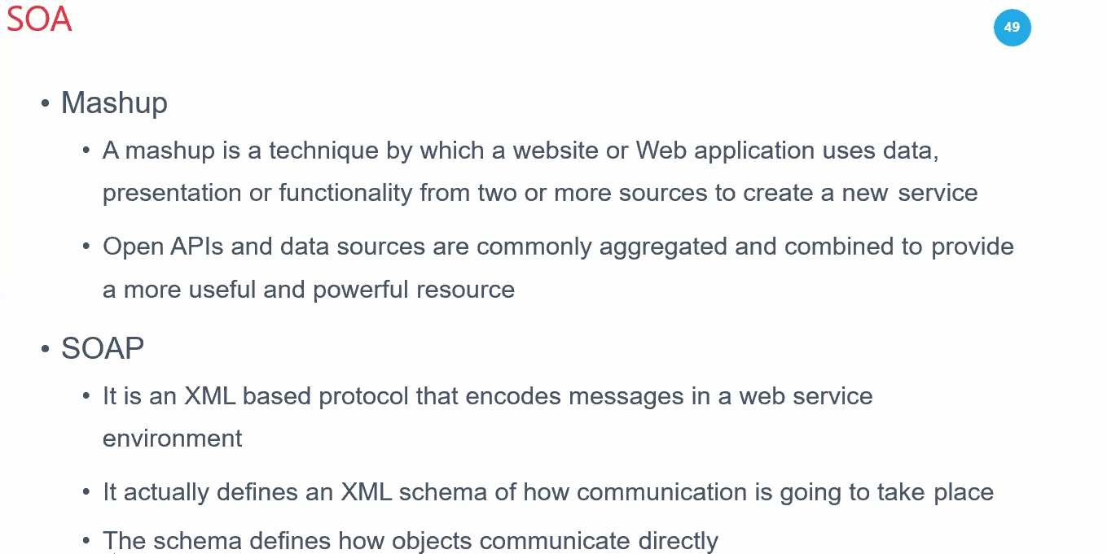

Slide 53
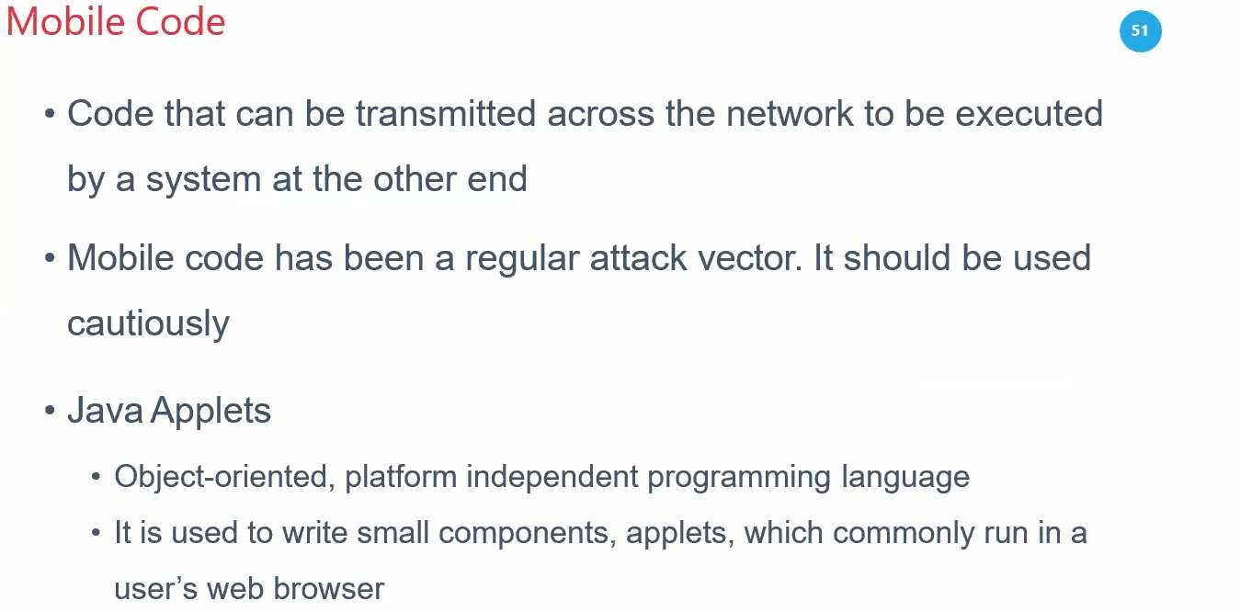

Slide 54
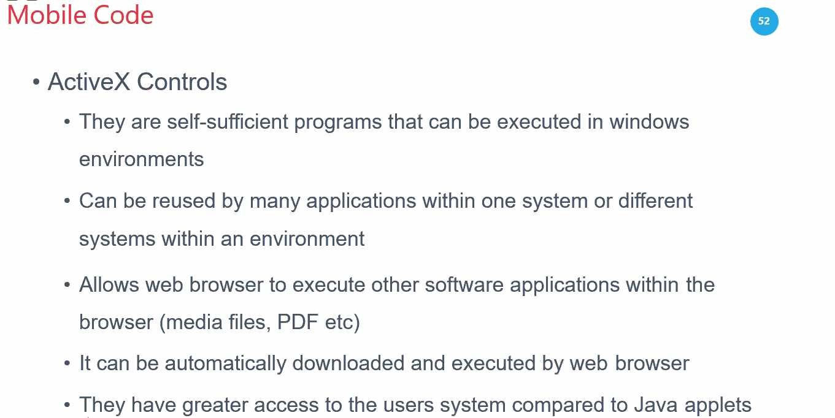

Slide 55

Databases

Slide 56
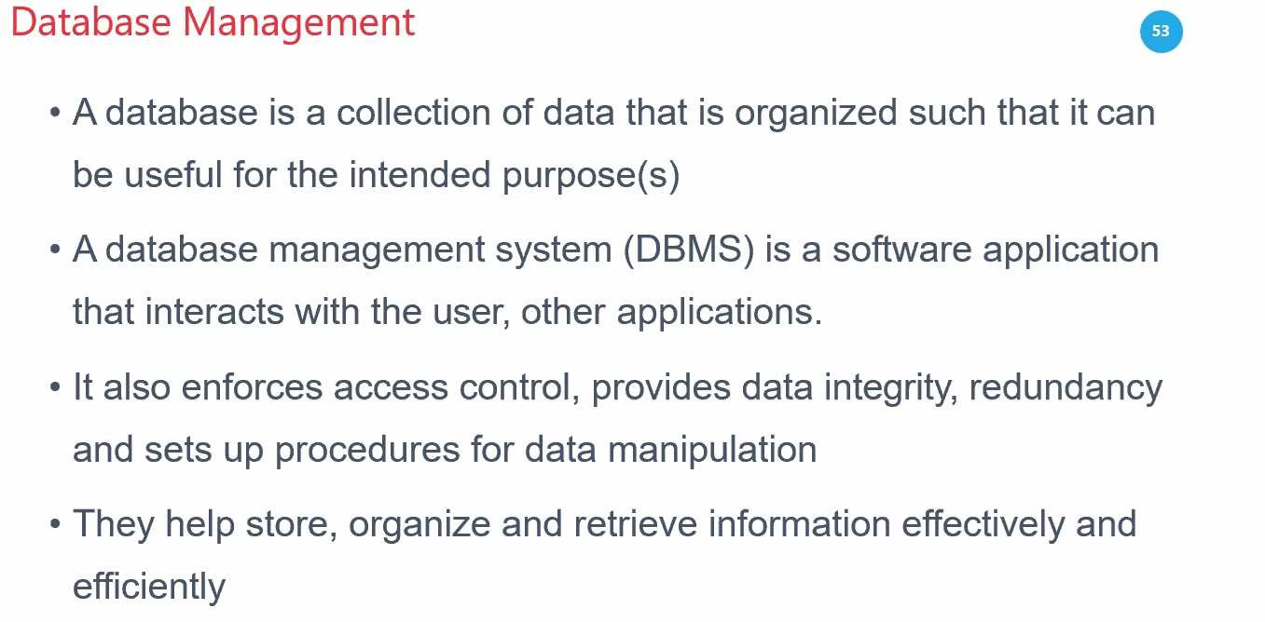

Slide 57
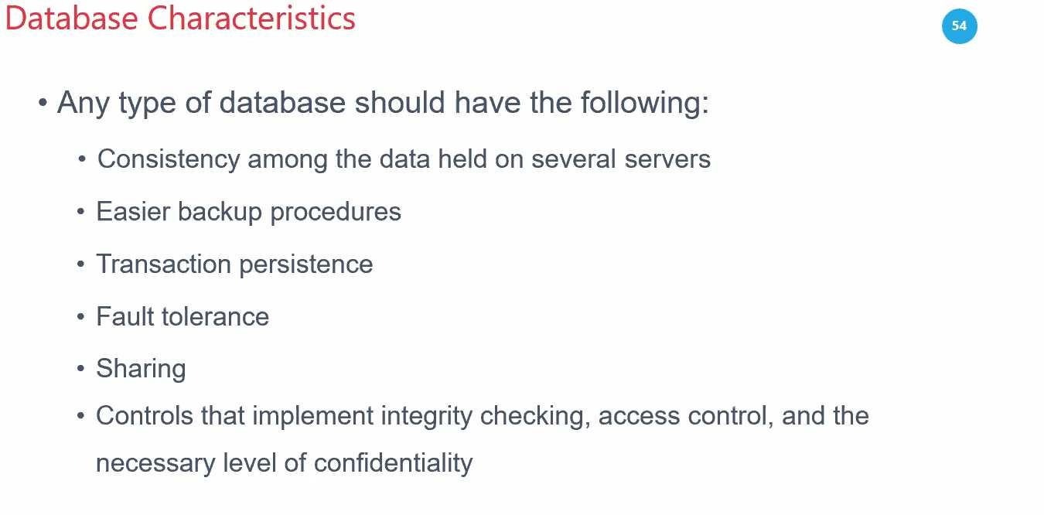

Slide 58
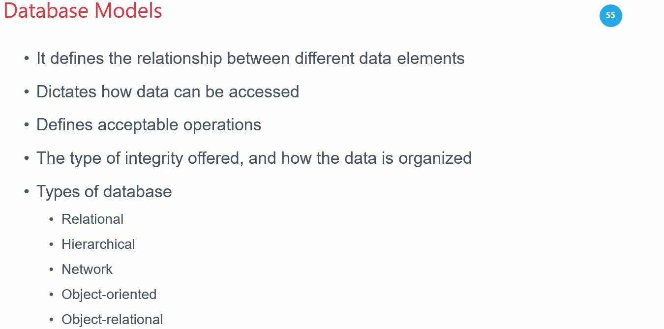

Slide 59
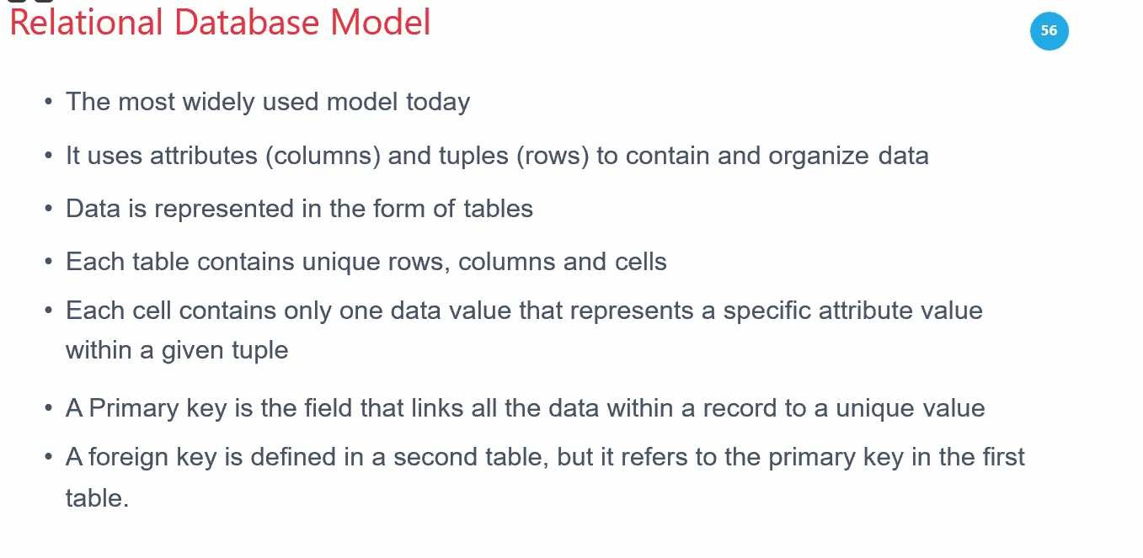

Slide 60
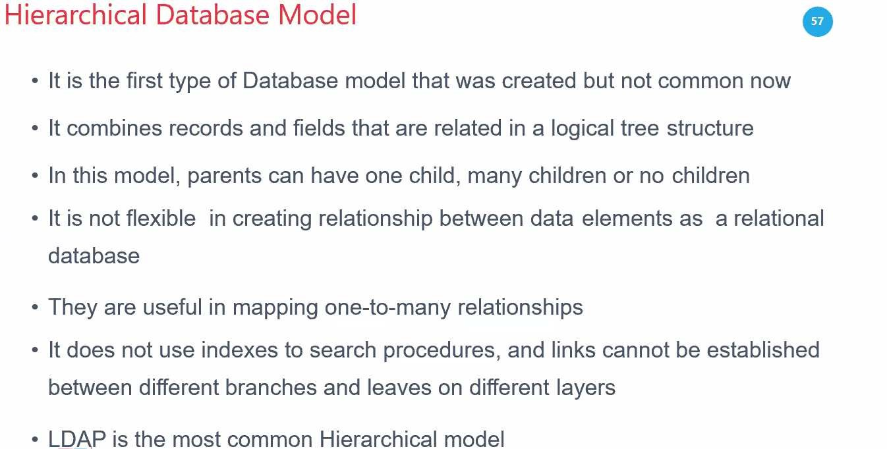
Notes:
Lightweight directory access protocol (LDAP) is a protocol that makes it possible for applications to query user information rapidly.

Slide 61
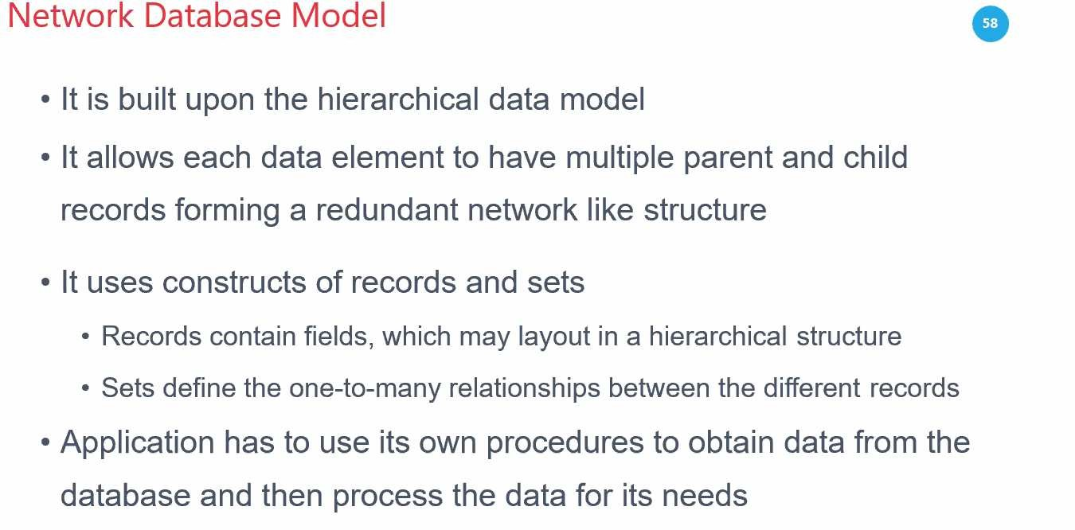

Slide 62
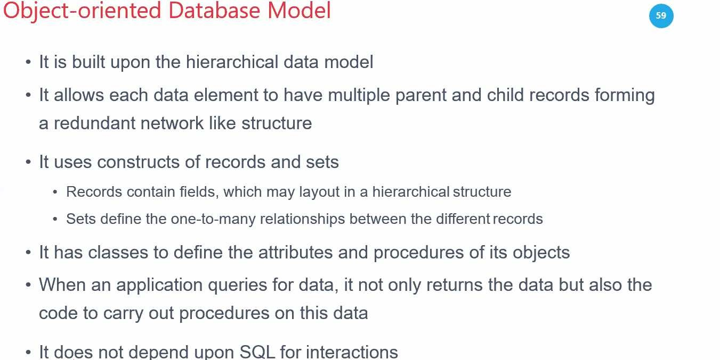

Slide 63
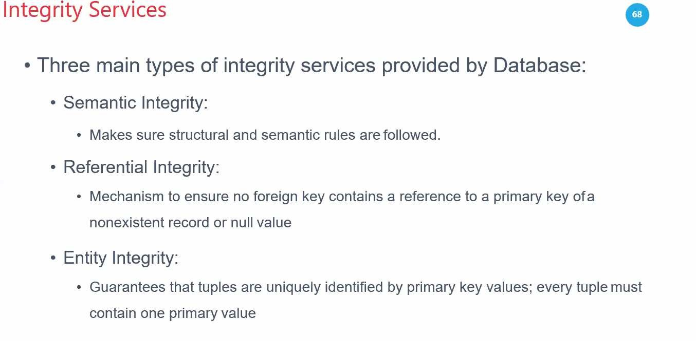

Slide 64
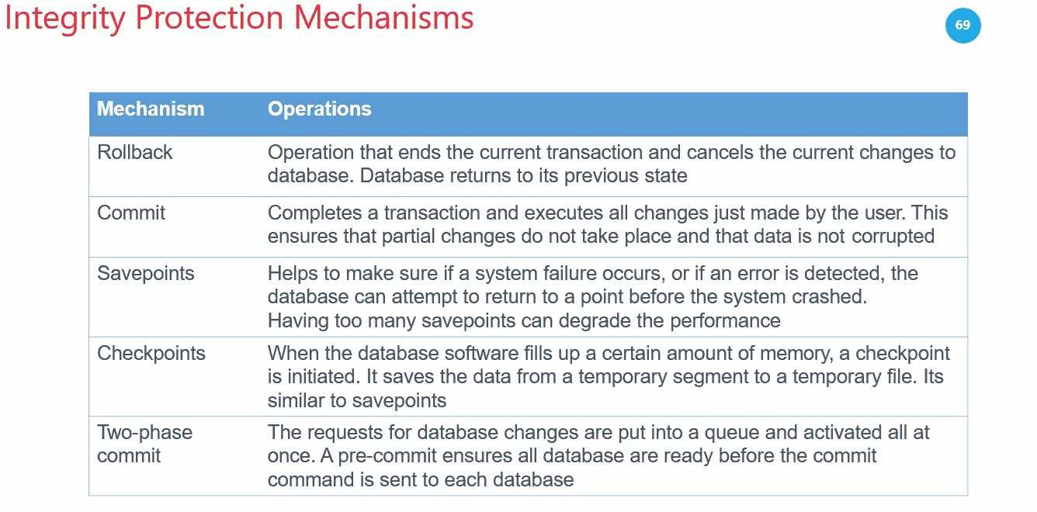

Slide 65
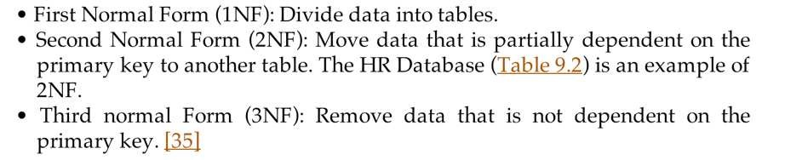
Database Normalization
•
Removes redundant data

Slide 66





Database Integrity
•
•
Mitigate unauthorized data modification Two users may attempt to change the same record simultaneously
The DBMS attempts to commit an update If the commit is unsuccessful, the DBMS can rollback and restore from a save point
Database journal logs all transactions
•
•

Slide 67



Database Replication and Shadowing
Highly Available (HA) databases
•
•
Multiple servers Multiple copies of tables
•
Database replication
•
•
Mirrors a live database
Original and copy are in use, serving clients
•
Shadow database
Live backup, not used

Slide 68




Data Warehousing and Data Mining
Data Warehouse
•
•
•
A large collection of data Terabytes (1000 GB)
Petabytes (1000 TB)
•
Data Mining
•
•
Searching for patterns
Ex: finding credit card fraud

Slide 69
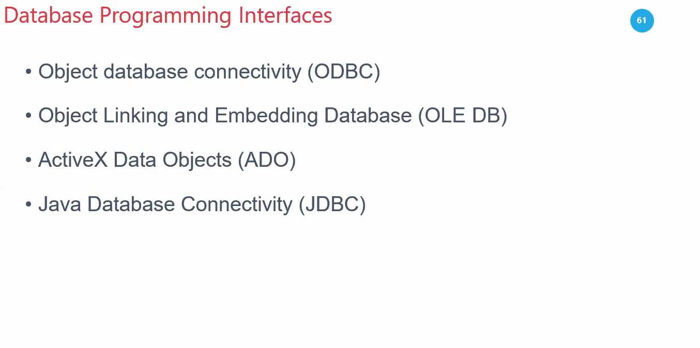

Slide 70
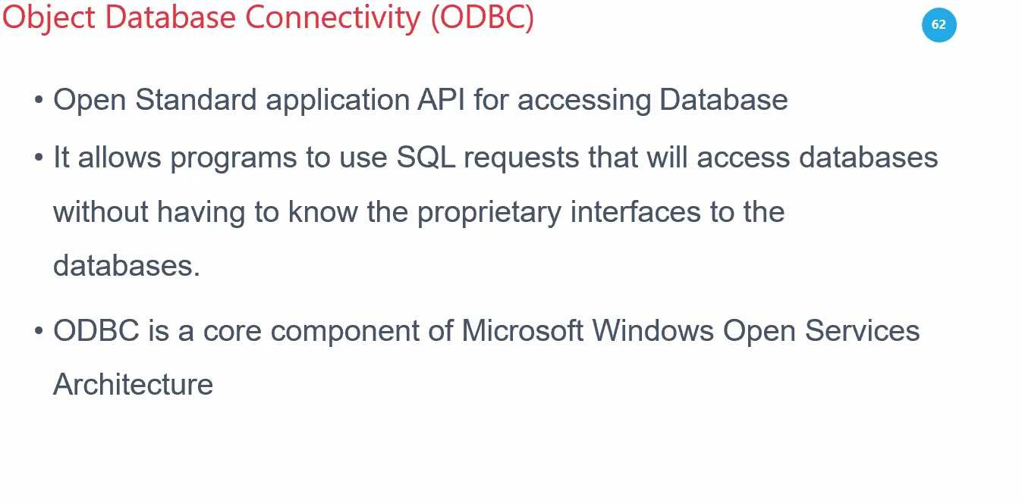

Slide 71

Notes:
A Component Object Model (COM) interface refers to a predefined group of related functions that a COM class implements, but a specific interface does not necessarily represent all the functions that the class supports.

Slide 72


Slide 73


Slide 74


Database Issues
Enumerating low-privilege data to find missing items, which must be
high-privilege
Aggregation attack
Combining many low-privilege records to deduce high-privilege data
•

Slide 75


Slide 76


Slide 77

Notes:
Online analytical processing (OLAP) and online transaction processing (OLTP) are two different data processing systems designed for different purposes. OLAP is optimized for complex data analysis and reporting, while OLTP is optimized for transactional processing and real-time updates.

Slide 78


Slide 79


Slide 80
Common Software Vulnerabilities
Buffer Overflow:
Definition: Occurs when more data is written to a buffer than it can hold, potentially causing crashes or code execution.
Prevention: Use languages with memory management or carefully check buffer boundaries.
SQL Injection:
Definition: Inserting malicious SQL code into a query to manipulate the database.
Prevention: Use parameterized queries and prepared statements to avoid executing harmful code.
Cross-Site Scripting (XSS):
Definition: Injecting malicious scripts into web pages viewed by other users.
Prevention: Sanitize and escape user input and use Content Security Policy (CSP) headers.
Cross-Site Request Forgery (CSRF):
Definition: Tricking a user into performing unwanted actions on a website.
Prevention: Use anti-CSRF tokens, SameSite cookies, and require re-authentication for sensitive actions.
Notes:
Understanding these vulnerabilities is key to preventing them during software development.

Slide 81

Assessing the Effectiveness of Software Security

Slide 82
Software Vulnerabilities
•
•
15-50 errors per 1000 lines of code
Windows 11 contains well over 50 million lines of code. This number is likely to increase with updates and new features.

Slide 83
Static and Dynamic Code Analysis Tools
Static Code Analysis:
Definition: Analyzes source code without executing it to identify vulnerabilities, code smells, and coding standard adherence.
Examples tools: SonarQube, Checkmarx, Fortify.
Dynamic Code Analysis:
Definition: Tests software during runtime to detect vulnerabilities that static analysis might miss.
Examples tools: OWASP ZAP, Burp Suite, WebInspect.
Advantages of Code Analysis Tools:
Early Detection: Identify vulnerabilities before deployment, reducing exploitation risks.
Automated Scanning: Integrate tools into the development lifecycle for continuous security.
Compliance: Ensure software meets industry security standards and regulations.
Notes:
Used to detect and fix software vulnerabilities throughout the development process.

Slide 84

OWASP Enterprise Security API Toolkits

Slide 85


Slide 86


Slide 87


Slide 88


Slide 89


Slide 90


Slide 91


Slide 92

Notes:
Buffer overflow attacks occur when input data exceeds the buffer's storage capacity, leading to potential crashes or unauthorized code execution. By implementing proper input validation, you ensure that the input size and type are within the expected parameters, preventing the buffer from being overloaded.
Other options, like encryption, firewalls, and intrusion prevention systems, do not directly address the root cause of buffer overflow attacks.

Slide 93

Notes:
A TOCTOU (Time of Check to Time of Use) attack exploits the time gap between when a system checks a condition (e.g., access rights) and when it uses the results of that check. This is a type of race condition vulnerability because an attacker can alter the system's state in between the check and the use, potentially gaining unauthorized access or manipulating data.

Slide 94


Slide 95


Slide 96
Security of Application Programming Interfaces (APIs)
API allows apps to use a service, like Facebook
API exploits abuse the API to compromise security

Slide 97

2021.

Slide 98

Software and Data Integrity Failures
Server-Side Request Forgery (SSRF)
Cryptographic Failures

Slide 99


Slide 100

Notes:
DOM stands for Document Object Model. It's a programming interface that represents an HTML or XML document as a tree structure. This tree structure allows developers to access and manipulate the document's elements, attributes, and content using programming languages like JavaScript.

Slide 101


Slide 102


Slide 103

1000$

Slide 104


Slide 105


Slide 106


Slide 107


Slide 108


Slide 109

Notes:
SQLMAP is an open-source penetration tool. SQLMAP allows you to automate the process of identifying and then exploiting SQL injection flaws and subsequently taking control of the database servers. In addition, SQLMAP comes with a detection engine that includes advanced features to support penetration testing.

Slide 110

Notes:
Most of the listed security issues, such as cross-site scripting (XSS), SQL injection, buffer overflows, and cross-site request forgery (CSRF), occur primarily due to improper or missing input validation. Properly validating and sanitizing input helps prevent attackers from injecting malicious code or exploiting vulnerabilities in the application.

Slide 111


Slide 112


Slide 113


Slide 114

Notes:
A man-in-the-middle (MITM) attack is a cyber attack in which a threat actor puts themselves in the middle of two parties, typically a user and an application, to intercept their communications and data exchanges and use them for malicious purposes like making unauthorized purchases or hacking.

Slide 115


Slide 116


Slide 117


Slide 118


Slide 119


Slide 120


Slide 121


Slide 122


Slide 123


Slide 124


Slide 125


Slide 126


Slide 127


Slide 128


Slide 129


Slide 130


Slide 131


Slide 132


Slide 133


Slide 134


Slide 135


Slide 136


Slide 137


Slide 138


Slide 139



Disclosure
Actions taken by a security researcher after finding a software vulnerability
Full Disclosure
Release all details publicly
•
•
Responsible Disclosure
•
•
Tell vendor privately
Give them time to patch it

Slide 140



Five Levels of Software Capability Maturity Model (CMM)
Initial - ad-hoc & chaotic
Depends on individual effort
Repeatable - basic project management
Defined
Documented standardized process
Managed
Controlled, measured process & quality
Optimizing
Continual process improvement
Notes:
From Carnegie Mellon
A methodical framework for creating quality software

Slide 141

Acceptance Testing
•
ISTQB (International Software Testing Qualifications Board) has 4 levels
•
•
•
•
User acceptance test Operational acceptance test Contract acceptance testing Compliance acceptance testing

Slide 142
Artificial Intelligence and Software Security

Slide 143





Expert Systems
•
Two components
Knowledge Base
•
•
If/then statements
Contain rules that the expert system uses to make decisions
•
Inference Engine
Follows the tree formed by the knowledge base

Slide 144



Multi-Layer Artificial Neural Network
•
Simulates real brains

Slide 145


Bayesian Filtering
•
Looks for probabilities of words in spam
v. good email

Slide 146

Genetic Algorithms and Programming
Simulates evolution

